Slide 1
CODESQUARD
Aachal Kushwaha(20241011610001)
Anshika Srivastava(20241011610032)
Anshu Nishad(20241011610033)
Disha Seth(20241011610064)

Slide 2

Case Study: Student Performance Prediction
This presentation applies machine learning techniques to predict student performance levels based on academic history, family background, and behavioral factors like study time and free time activities. By identifying students at risk of failing, timely interventions can be designed to improve their academic outcomes.

Slide 3
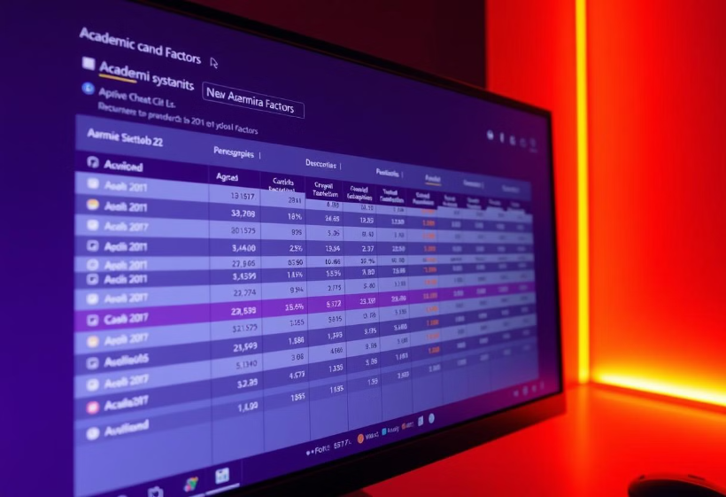
Introduction
Objective:
To predict student performance using machine learning techniques based on academic, behavioral, and demographic factors.
To identify at-risk students early and suggest timely interventions.
To analyze which factors (attendance, prior grades, study habits, family background) influence student outcomes the most.
To improve the educational support system by providing insights for teachers and policymakers.

Slide 4
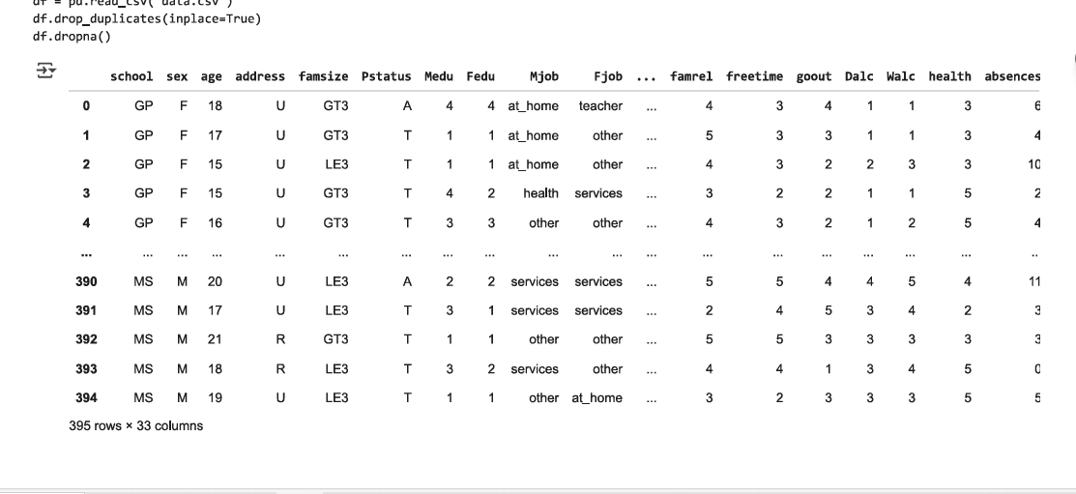
Dataset Overview:
Data Source: data_csv (student performance records)
Key Features:
Academic Performance: G1, G2, G3 (final grade), study time, failures, etc.
Demographic Factors: Gender, age, family size, parental education, etc.
Behavioral Aspects: Free time, goout, alcohol consumption (Dalc, Walc), etc.
Family Influence: Parent’s job, relationships, etc.

Slide 5


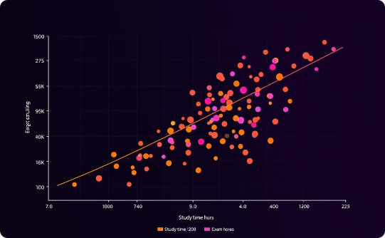
Data Preprocessing & Feature Engineering
Data Cleaning
Feature Encoding
Scaling & Data Splitting
Handling missing values (imputation). Removing outliers.
Converting categorical variables to numerical (one-hot encoding).
Normalizing numerical features.

Slide 6
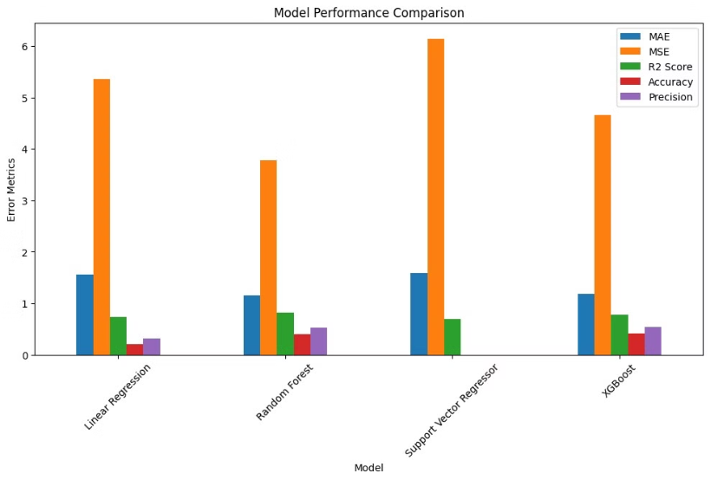
Evaluation Metrics & Results
Metrics Used:
Mean Absolute Error (MAE): Average prediction error.
Mean Squared Error (MSE): Penalizes larger errors.
R² Score: Indicates how well the model explains the variance in the data.
Results Overview:
Random Forest: Best performance with lowest MAE & MSE, and highest R².
Linear Regression & SVR: Lower accuracy compared to ensemble models.

Slide 7

Conclusion
Summary: Machine learning effectively predicts student grades, enabling early intervention.
Impact: Personalized learning approaches and enhanced educational strategies.
Next Steps: Improve model accuracy with more data and advanced algorithms.

